Slide 1
Aspects of Dementia
Dr Saeed
Lightwater Surgery

Slide 2
Understanding Dementia
A collection of symptoms and signs, that encompass difficulties in memory (short term), language (speaking; finding the right words), cognitive processing (thinking, planning, problem solving) and behaviour (mood and personality) that leads to impairment in activities of daily living (balance, moving, washing and dressing).
Happens when the brain is damaged by disease; affects people of all ages.
Not just simple “forgetfulness”

Slide 3
The Brain
The brain has billions of nerve cells called neurons, which carry messages between different parts of the brain.
Dementia causes damage to neurons.
The brain controls everything, so if messages are not received then this will lead to difficulties.

Slide 4
How dementia affects the brain

Slide 5
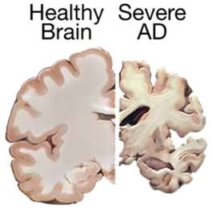
The brain on the right is that from a patient with Alzheimer’s Disease.
It has shrunk, due to the degeneration and death of neurons

Slide 6
Dementia types
Alzheimer’s
62% of dementia
Memory loss
Decreased judgement
Decrease in communication
Global impairment

Slide 7
Vascular
17% of dementia
Associated with circulation issues
Behavioural changes
Unsteadiness, depression
Incontinence

Slide 8
Lewy Body
5% of dementias
Associated with Parkinson’s disease
Hallucinations
Falls
Sleep
Fluctuating cognition

Slide 9
Mixed Dementia
10% of dementia; combination of Alzheimer’s and Vascular
Frontal Lobe Dementia
2% of dementia; rare, younger onset, memory initially intact, speech reduction, early loss of insight, emotional blunting, incontinence

Slide 10
How Big is the Problem?
Estimated to be 982,000 people in UK
By 2040, rise to 1.4 mil
1 in 11 over age 65 have dementia
20% of over 80s
600 people develop dementia daily
More women than men
Contributes to 25% of hospital admissions
Health and social cost more than cardiovascular disease and cancer combined!

Slide 11
Risk Factors
Age: advancing years, incidence doubles every 5 yrs after age 65
Family/Genetics: several genes increase the risk for Alzheimer’s, affecting brain proteins, family history increases risk but familial forms are rare
Gender: more women with Alzheimer’s and more men with Vascular dementia
Diabetes / Hypertension / High Cholesterol / Head Injury / Depression / Smoking and Obesity

Slide 12
Early Signs
Memory loss: short-term memory, disorientation/getting lost, repetition
  What time is it? = ? What am I doing here?
  Can I go home? = ? I am not comfortable
  Work out what is behind the questioning
Difficulty with familiar tasks: cooking meals, organising tasks
Problems with language: word finding, naming
Poor judgement: e.g. dressing inappropriately for weather, challenges understanding visual and spatial information (misjudging edge of furniture/ pouring liquids)
Trouble keeping track of things: conversations, finances, date/time etc

Slide 13
Misplacing things: putting things in unusual places
Changes in mood or behaviour: depression, mood swings, disinhibited, aggression
Change in personality/behaviour: irritable, suspicious, anxious, asocial, aggression, incontinence/ hygiene, unable to distinguish dreams/ reality
Loss of initiative: passive, increased sleeping, loss of interest

Slide 14
What should you do next?
Make an appointment to see a GP
Come with a family member; useful for collateral history and get a fuller picture of recent months
We will arrange blood tests, as sometimes people can have memory symptoms that are a sign of different diseases
We will do brief memory tests and may also give some “homework” to bring back in
We will refer you to the Memory Clinic, in Camberley for a more detailed assessment and scan
The Memory Clinic will make the final diagnosis

Slide 15
Benefits to early Diagnosis
Can be a relief and end any uncertainty
Enables people to understand their condition
Early access to treatment to relieve symptoms
To access support / carer support
Access to information
‘Opening a door’ – for future care
Legal – Power of Attorney, Wills, Living Wills
Financial planning
Life / advanced care planning→ may reduce inappropriate hospital admissions in future
Annual physical / mental / social and medication reviews with the surgery
Evidence suggests most people want to know

Slide 16
Disadvantages
Distress / Lack of cure
Depression / Anxiety 77% people
Social isolation and loneliness in 60% people
Worry about stigma
May feel like an invalid / no purpose
48% can feel like a burden to family

Slide 17
Post Diagnosis Support
Review understanding of diagnosis
Alzheimer’s Society, local memory cafe
Practical support: cognitive training/rehabilitation
Psychological therapy: difficulty adjusting to diagnosis
Discuss medico-legal issues eg. driving
Information regarding financial and legal advice

Slide 18
Carer Support
Carers of People with Dementia: can have more mental health problems/ burnout
Guilt
They need a break
Worse physical health
Living bereavement
Educational resources for carers

Slide 19
Treatment
No cure
But medication is available in Alzheimer’s disease/ Lewy Body Dementia that can minimise the impact of illness

Slide 20
Cholinesterase Inhibitors
Donepezil/ Rivastigmine/ Galantamine
Used in mild-moderate dementia
To improve daily functioning and concentration
NNT 1:14
Can cause sickness/ diarrhoea/ slow pulse/ heart block

Slide 21
NMDA Receptor Antagonists
Memantine
Used in moderate-severe dementia
To improve daily functioning/ cognition and help behaviour can be used with Donepezil
Can cause headaches/ breathlessness/ high blood pressure
Again NNT 1:14

Slide 22
Behavioural Changes
Restlessness
Physical aggression
Agitation
Wandering
Sexual disinhibition
Shadowing
Mood changes
Delusions/ hallucinations

Slide 23
Can be worsened by
Infection/ pain/ constipation
Activities
Drug side effects
Noise
Delerium

Slide 24
What else can we do???
Look out for pain
Remember how they were in the past and recognise their worth today
Avoid unhelpful phrases eg “why did you do that?”
Do not try to takeover
Daily routines
Avoid arguing, communication has purpose, they are just trying to express a feeling
Divert rather than reason
Help with medication
Re-assure, treat with respect and dignity

Slide 25
PREVENTABLE?
Physical activity
Nutrition
Mental stimulation
Socialisation
Creativity & Attitude – stress reduction

Slide 26
“What is good for the heart is good for the brain”
Cholesterol/ BP/ Obesity/ blood vessel narrowing/ damage
When you exercise your heart, have low blood pressure and keep your weight low, it helps the brain too!

Slide 27
Physical Activity
2.5 hrs exercise per week
Walk
Use stairs/ gardening
Swimming
Cycling
Dancing
Tai-Chi
Lower risk dementia in those who walk 5 miles per week
Slow progression of cognitive impairment in those who walk 5 miles daily

Slide 28
Nutrition
Avoid processed food, fatty foods salt
Mediterranean diet- fruit/veg/ olive oil/ legumes/ grains/ oily fish
Anti-oxidants- dark greens/ leafy veg/ fruit/ green tea/ blueberries/ vitamins E+C

Slide 29
Mental Stimulation
Train and exercise your brain
“use it, or lose it”
Crosswords, puzzles, jigsaws, reading, scrapbooks (pictures/ memorabilia), memory box (for personal and significant objects)
Appropriate level; adapt to changing abilities
If reading becomes difficult, read to them
Talk about something familiar to allow them to join in

Slide 30
Socialisation
Important to remain connected to people
Most people are naturally social creatures
Watch films and favourite programmes & fun things together- Reminiscence Therapy
Trust others, so that they can help if needed in the future
Lowers memory loss by keeping mind active and happiness can lead to lower blood pressure and better immune function

Slide 31
Creativity, Attitude & Spirit
Manage stress
Aromatherapy, diet & exercise, mindfulness and meditation
Antidepressants
Be creative and human
Music, art and dancing
Different part of brain used for these memories and often not affected as quickly
Calm/ Safe environment for wondering

Slide 32
What does it feel like?
Everyone is individual, so the condition and their ability to cope with the symptoms will affect them in different ways.
Different types of dementia can lead to different parts of the brain being affected.
In the early stages of dementia, people can often manage independently or with very little help.
But, as the condition progresses, people will need more support and understanding, especially from family and friends.

Slide 33
How to help?
It’s important for people with dementia to stay as independent as possible but this will become more difficult as their symptoms get worse
Helping them may be seen as interfering, so it is not always easy to know how and when to provide support
Asking the person if they would like some help to do something can make it easier for them
to accept
Be patient

Slide 34
Dementia Friends
Alzheimer’s Society programme
Changing public perception of dementia
Learning about what it is like to live with dementia
Turning that understanding into action
Can then volunteer to be a Champion and encourage others to learn more about dementia

Slide 35
Driving
May be able to continue driving
Must fulfil certain legal requirements
Inform DVLA about diagnosis who then make an assessment
If unsure, can take a driving assessment

Slide 36
Stop driving if:
Less confident
Getting lost on familiar roads
Misjudging speed/distance
Straying across lanes or hitting kerbs
Risk of having an accident
Passenger concerns

Slide 37
How to encourage driving to stop:
Acknowledge difficulty
Encourage them to take charge of new transport arrangement
Set up a taxi account
Pay bills and shop online
Point out benefits of not driving
Saving money on petrol and car insurance
Not having to find parking spaces
Not getting caught in traffic
Public transport can be social
May want to walk which would provide exercise

Slide 38
Financial Support & Benefits
Patients and carers may be entitled to:
Attendance Allowance
Personal Independence Payment
Carer’s Allowance
Council Tax Reduction
Blue Badge

Slide 39
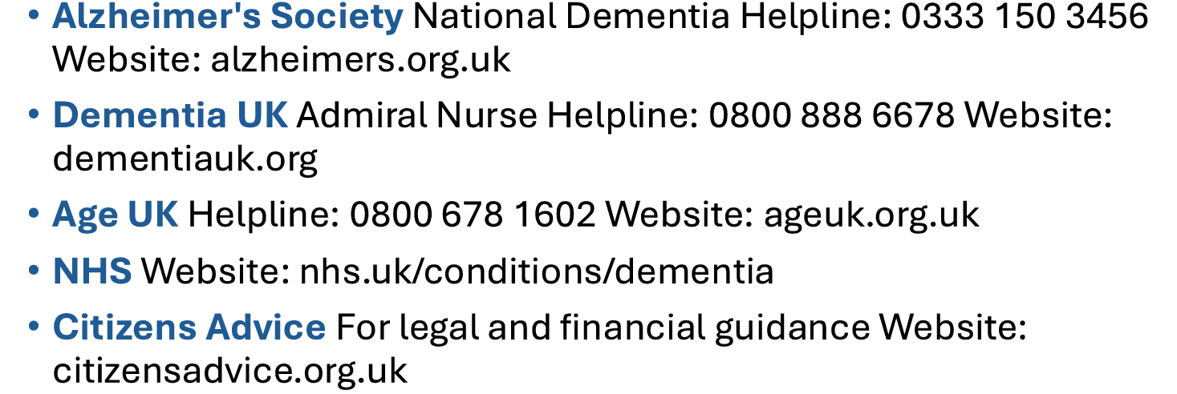
Useful Information

Slide 40
  Chit Chat and Chores: Support for local people and their carers in the community hello@chitchatandchores.co.uk
  Navigating Dementia Desk: 1st Monday of the Month in Bisley run by Surrey County Council
  Camberley Alzheimer Café: Held at St. Martin’s Church (3rd Monday of the month). A place for education and socialising.
  Mytchett Memory and Friendship Group: Tuesday afternoons at the Mytchett Centre.
  Melody for the Mind: Singing and fun at High Cross Church, Camberley. 1st and 3rd Fri afternoons
  Admiral Nurse Helpline: 0800 888 6678

Slide 41
Windle Valley Day Centre, Bagshot. Saturday club 2pm-5pm
Miriam Grace at St Anne’s Church Hall Bagshot Mon – Thurs 10am-4pm
CMTOP will keep referral open for 6 months and offer post diagnostic support
Social prescriber can be a good port of call/ signposting
Dementia café Windlesham Church
Social services and Community Matron

Slide 42
Support for Carers:
Action for Carers Surrey: Offers a dedicated Camberley Hub at High Cross Church for advice and "check-in" calls. 2nd and 4th Tue of the month 10am-2.30pm.
Dementia Support Surrey Heath & Farnham: Provided by Alzheimer's Society, offering 1-to-1 help. 0333 150 3456

Slide 43
Practical Daily Help:
•Surrey Heath Age Concern (SHAC), Befriending, agility classes, 01276 748882, Pembroke Broadway, Camberley
Age UK Surrey (LPA & Info), 01483 503414 (Mon-Fri 10am-4pm)

